Slide 1
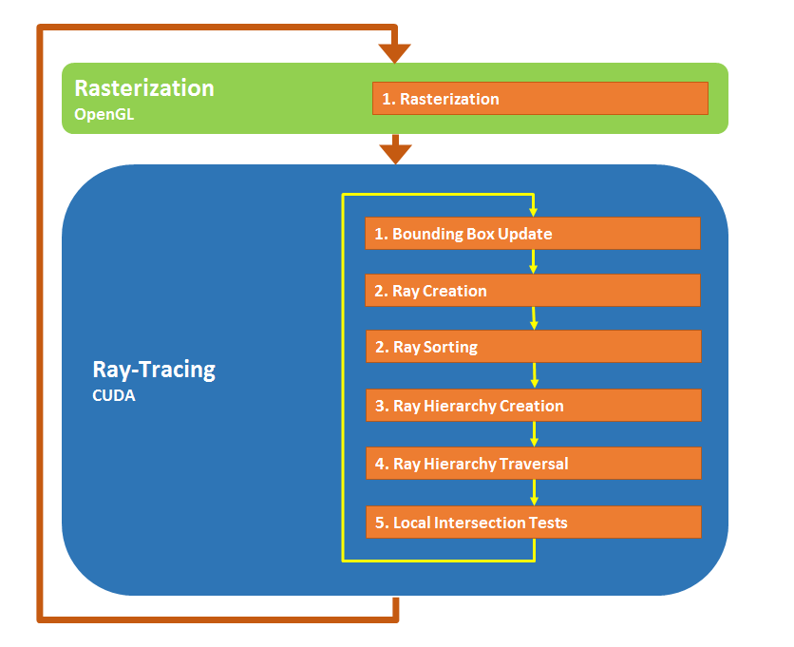
Ray-Space Hierarchy Algorithm
Nuno T. Reis
Instituto Superior Técnico, Portugal
nunotiagoreis@tecnico.ulisboa.pt

Slide 2
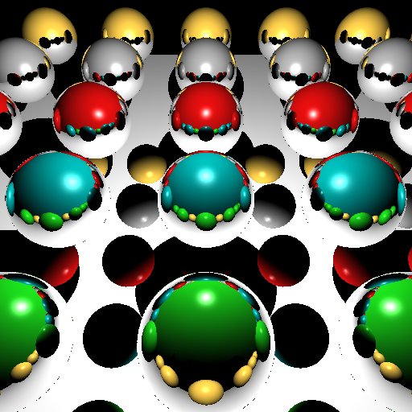
Early Development Image
Important Notes:
OpenGL Rasterizer outputs the necessary information to create the Secondary Rays
The Ray Hierarchy is composed of Bounding Spheres and Cones
Different Hashing functions are used for different types of secondary Rays for maximum efficiency.
Early Results:
95% of reduced intersection tests compared with a Naive Ray-Tracer
Creation of the Ray Hierarchy in just a few milliseconds.

